Slide 1
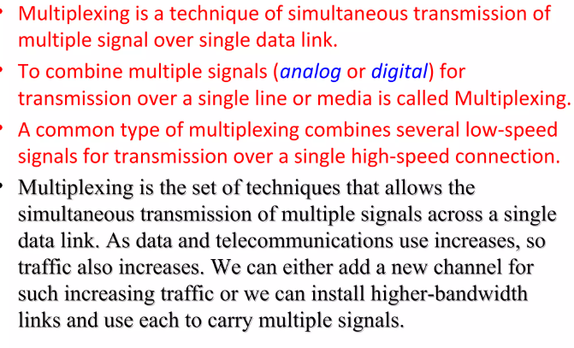
MULTIPLEXING

Slide 2
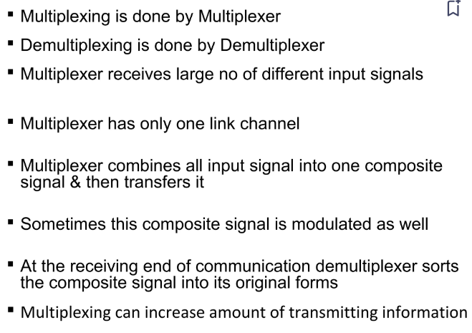

Slide 3
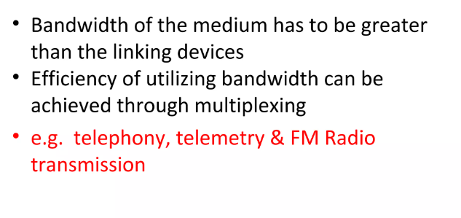

Slide 4
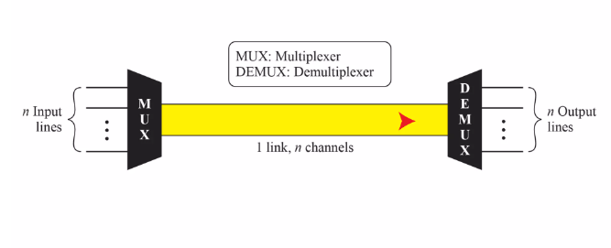
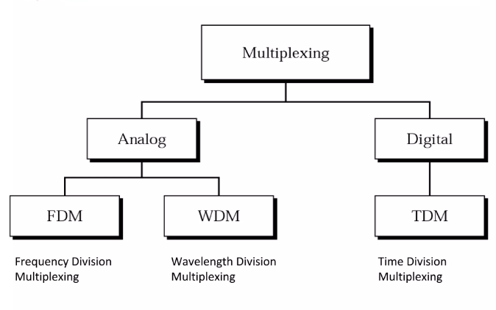

Slide 5
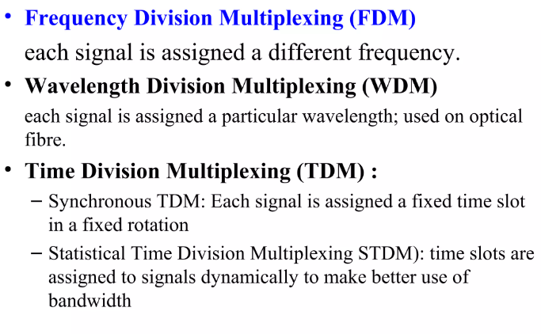
Categories of Multiplexing

Slide 6
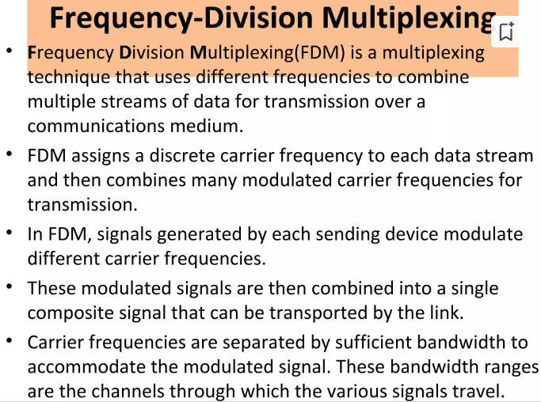

Slide 7
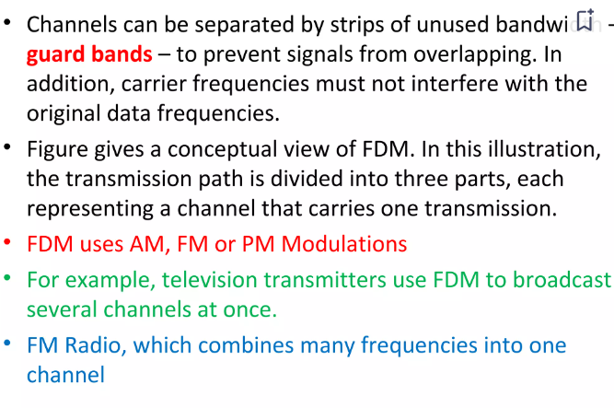

Slide 8
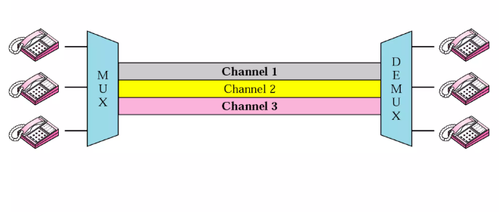
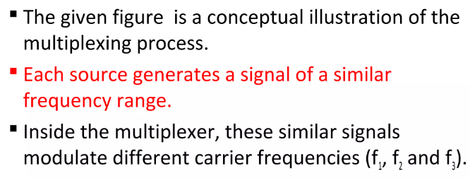
Multiplexing Process

Slide 9
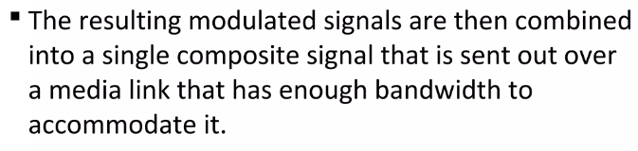
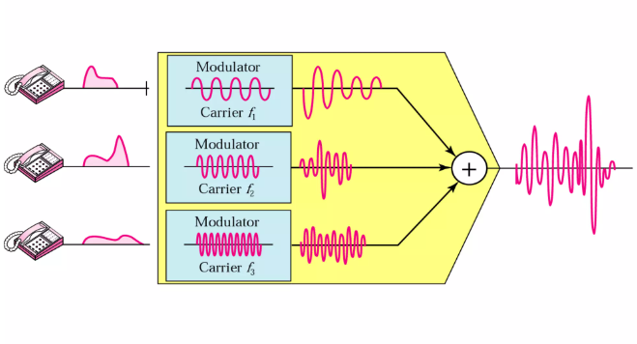

Slide 10
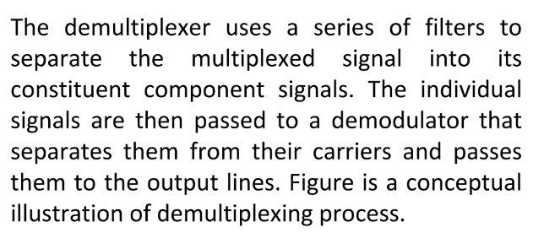
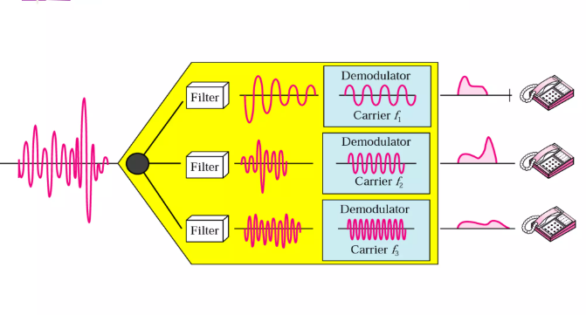
Demultiplexing Process

Slide 11
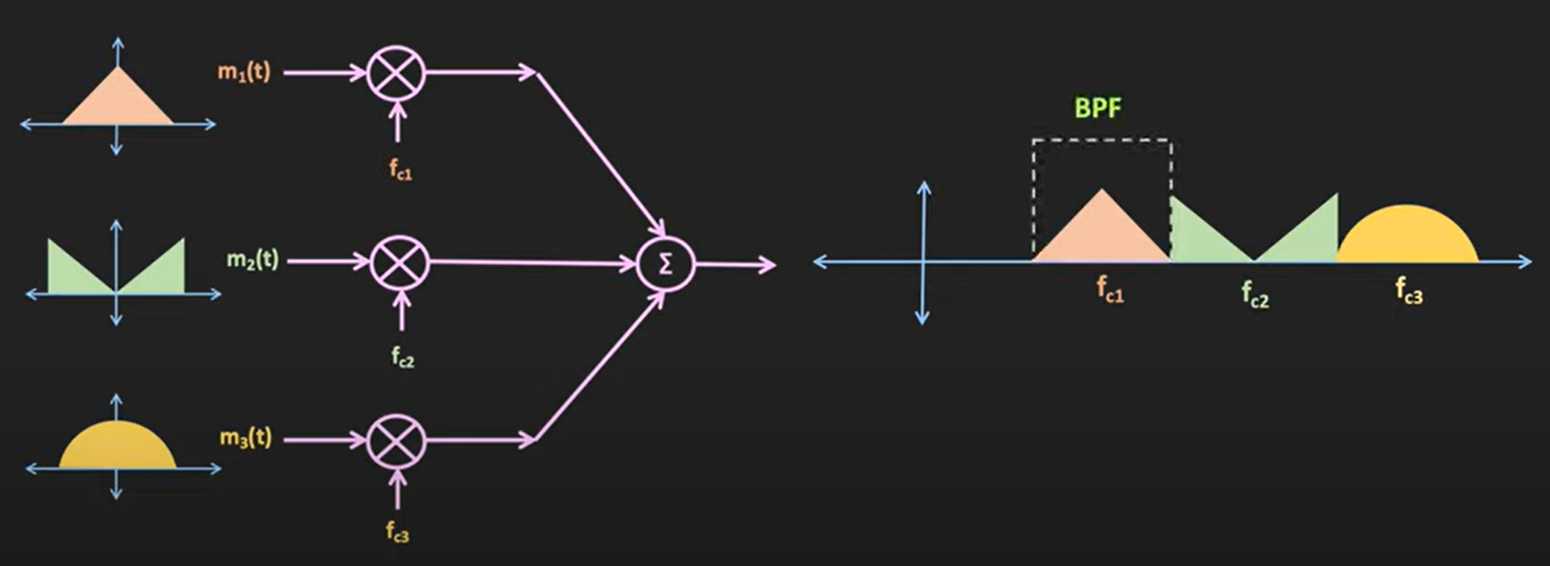
At receiver using band pass filter each message signal can be separated . Frequency of each signal should be such that the signal donot overlap each other Each BPF is tuned to a particular frequency and the BW should be enough to pass the message signal

Slide 12
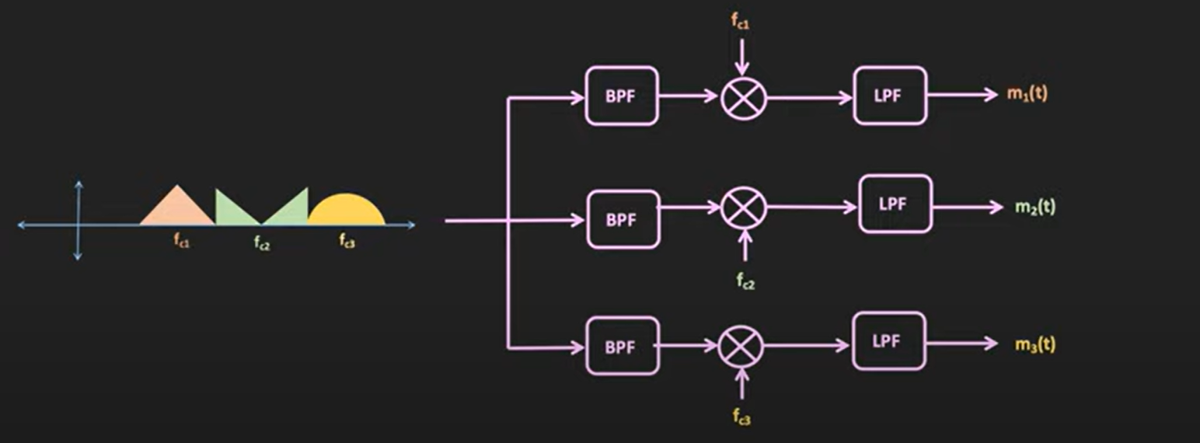
At receiver with the help of BPF the individual message signal are separated. Output of each BPF is demodulated and then this demodulated signal is passed through low pass filter. So after demodulation we get the signal back.

Slide 13
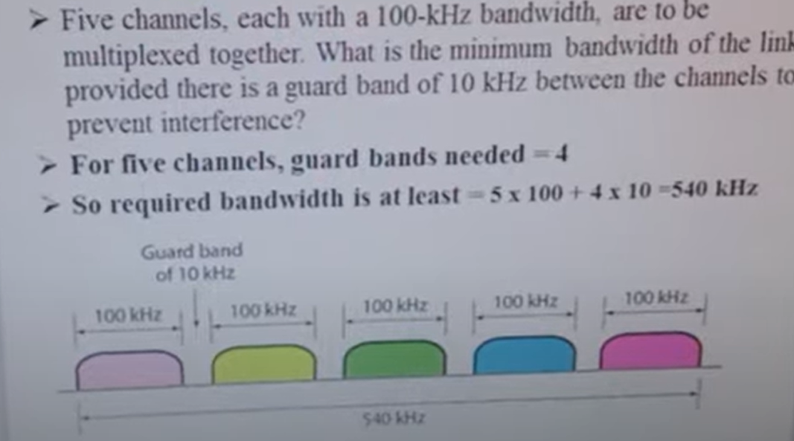

Slide 14
Time Division Multiplexing
The basic parameter on which we do multiplexing is based on time.
The sampled PAM waveform is off for the most of the time
During this off period it can be used to transmit signal of other waveform
The concept of interleaving samples from several signal into a single waveform is TDM

Slide 15
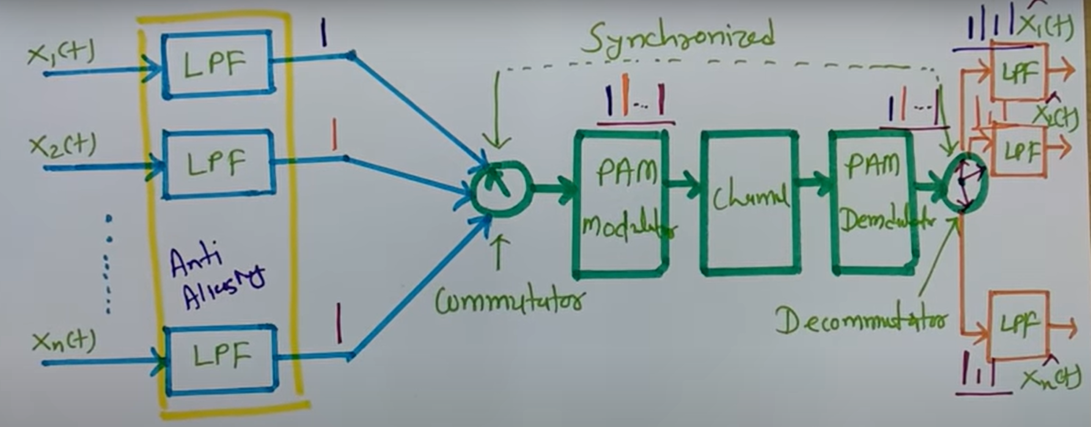

Slide 16
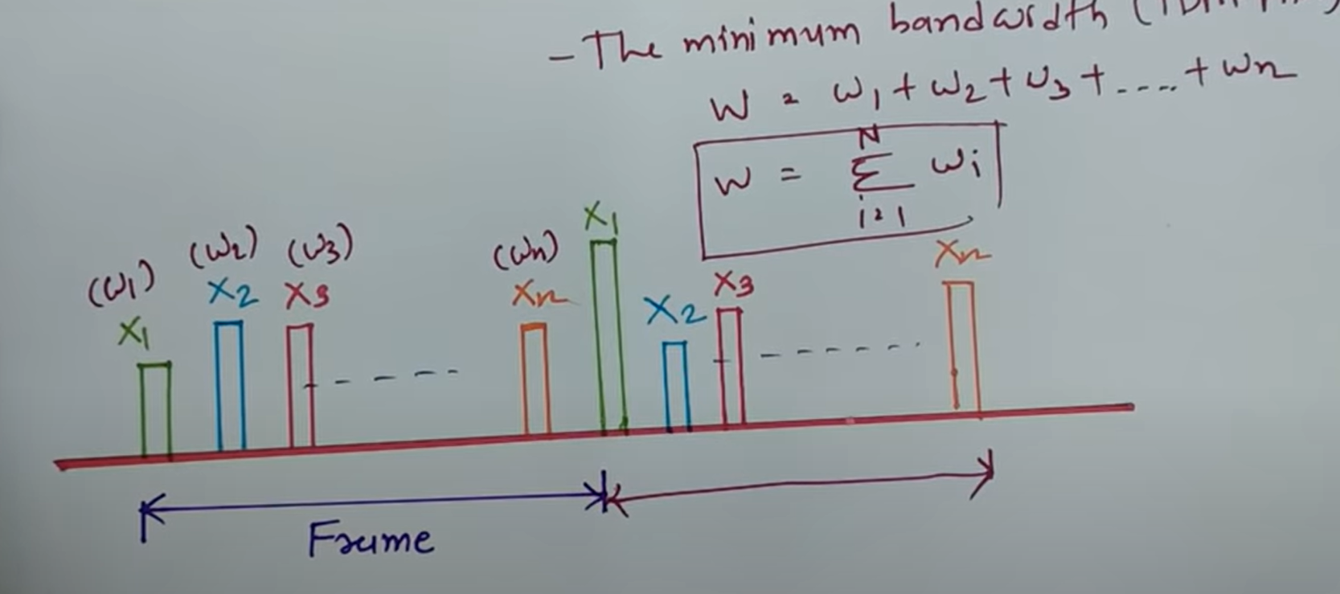
Frame-It is time required to rotate the commutator for one revolution.

Slide 17
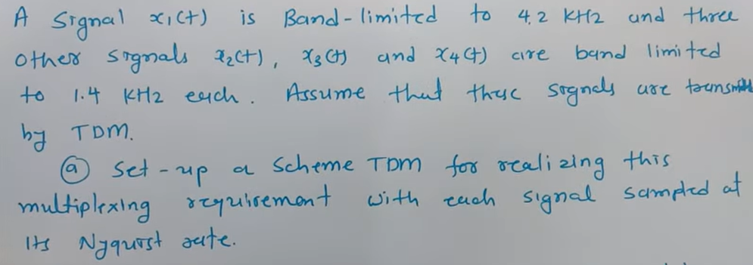
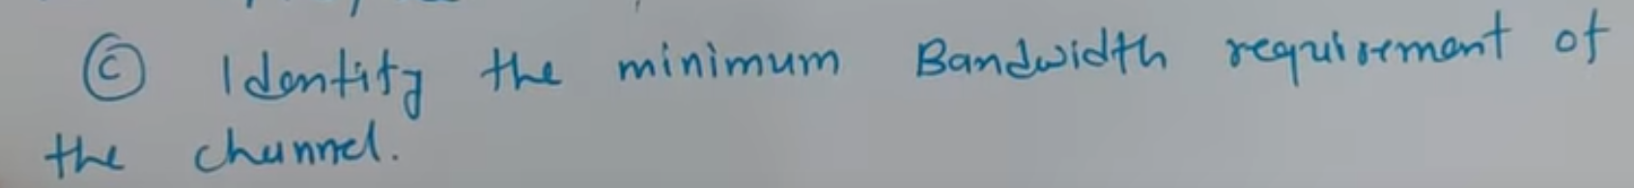
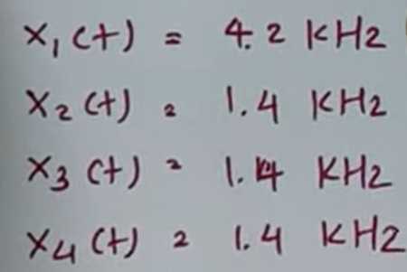

Slide 18
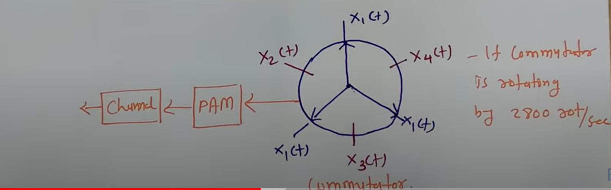
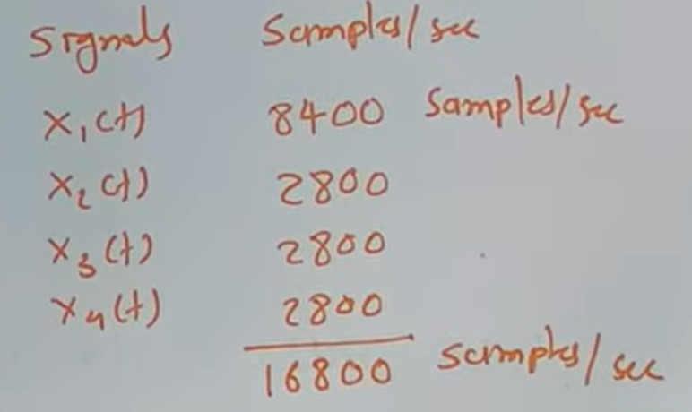

Slide 19
